Slide 1


NHL Player valuation and trade Recommendation system
Sangmun kim, Yuyang Chen, Haichen Sun, Michael Kuby

Slide 2
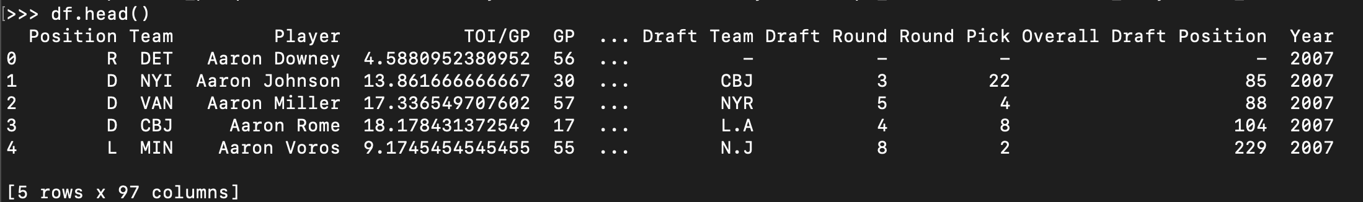
Challenge: Predict the salary of a player based on performance Metrics
Recall: Y = Xw
X: Performance Metrics for 2007 - Present
Y: Salary For 2007 – Present
w: To be learned

Slide 3
Workflow Step 1: Procure the data
X (Performance Metrics): Scraped from www.NaturalStatTrick.com
Y (Salary Data): Scraped from www.CapFriendly.com

Slide 4
Workflow step 2: Entity Resolution
Performance Metrics
Merged via Entity Resolution Process
Salary Data

Slide 5
Workflow step 3: Exploratory Data Analysis
Performance Metrics
Merged via Entity Resolution Process
Exploratory Data Analysis
Salary Data
Task: Find the columns of X most closely correlated with Y.
Tools: Correlation Analysis, Matplotlib/Seaborn
Other: Principal Component Analysis

Slide 6
Workflow step 4: Train a regression model
Performance Metrics
Merged via Entity Resolution Process
Exploratory Data Analysis
Train (Regression)
Salary Data
Decisions and Challenges:
Multiple models (one for each position)?
Format for our Y’s (how to adjust for inflation)?
Tools (AutoML)?

Slide 7
Workflow step 5: Predict
Exploratory Data Analysis
Train (Regression)
Predict
Understanding the predictions:
“Predictions are what the model thinks the player is worth, given their performance.”
A measure of value.

Slide 8
Workflow step 6: Player Evaluation
Train (Regression)
Predict
Evaluate
Player Evaluation:
If Value – Salary > 0:
Player is overperforming
If Value – Salary < 0:
Player is underperforming
Consider: Every player already has a salary.
Recall: Prediction = value

Slide 9
Workflow step 7a: Recommend
Predict
Evaluate
Recommend
Recommend: Given a player that we would like to trade, what players should we target?
Player to trade: underperformer
Player to target: overperformer
Constraint: Should have a comparable salary.

Slide 10
Workflow step 7b: Recommend
Predict
Evaluate
Recommend
Time Permitting: Include sentiment analysis by analysis /r/{hockey, teamA, teamB, …}
Players to target: overperformer + sentiment analysis

Slide 11
Workflow step 8: Product
Evaluate
Recommend
Product
Product: A web-based interface
Features:
Select Team → Select Player → View valuation and relevant metrics.
Produce a list of players identified as possible trade targets.

Slide 12

THANK YOU!

